Slide 1
Python Basics
(Session -2)

Slide 2
Overview
Topics We’ll Be Covering
Introduction
Data Types
Operators
Input Output
Flow Control
String Operations
Practice Set -1
Pythonic way of problem solving
Data Structures (List, Tuple, Set, Dictionary)
Functions
Modules and Packages
Class and OOPs
Practice Set -2

Slide 3
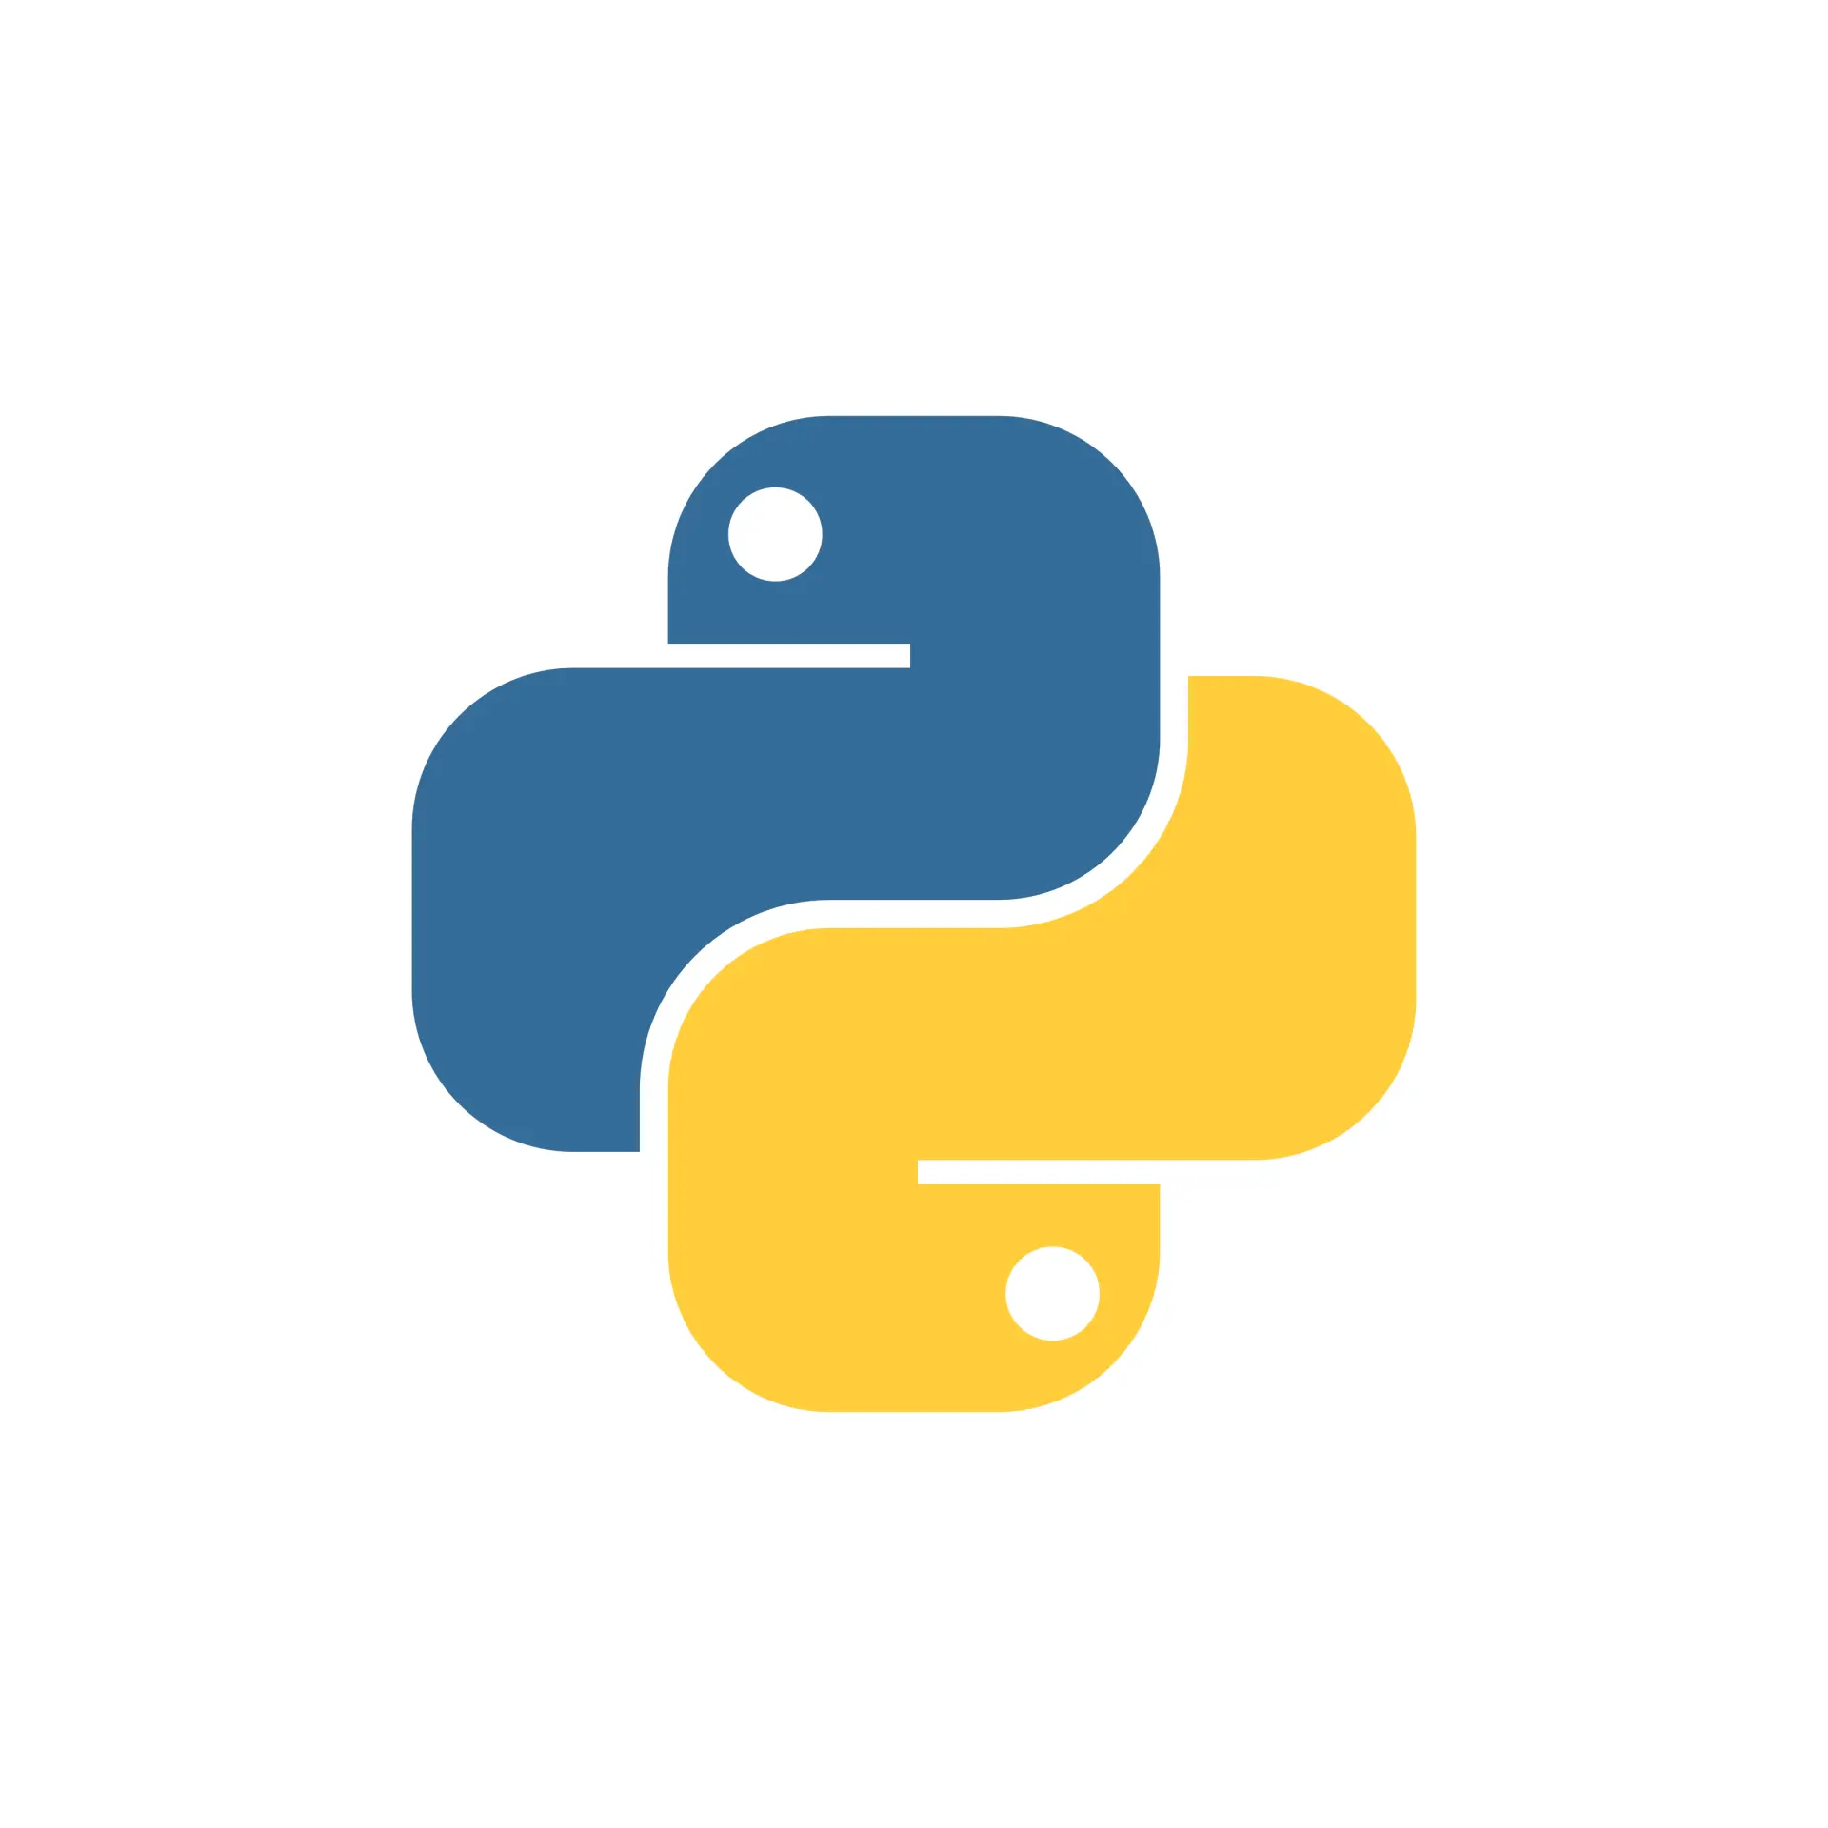
Introduction
Python is a high-level, general-purpose programming language known for its readability and versatility.
Its design philosophy emphasizes code readability, making it easier to learn and use compared to some other languages. Python is used in various domains, including web development, data science, machine learning, and scripting.
Why Python is still relevant and popular?

Slide 4
Introduction
Python was created by Guido van Rossum in the late 1980s at Centrum Wiskunde & Informatica (CWI) in the Netherlands.
It was conceived as a successor to the ABC programming language, which van Rossum had helped develop. Python's design was influenced by ABC but also incorporated features from other languages like C, Modula-3, and Lisp.
Python (0.9.0) was released in 1991
Name is tribute to the comedy series: Monty Python's Flying Circus.
Python 1.0 was released in 1994 (included features of functional programming)
Python 2.0, released in 2000 (list comprehension, garbage collection, and Unicode support)
Python 3.0, a major version released in 2008 (major update)
Python 2.x stopped having upgrade after 2020
Development is managed by PSF

Slide 5
Introduction
Key Features of Python:
Readability
Versatility
Large Standard Library
Extensive Third-Party Libraries
Cross-Platform Compatibility
Open Source

Slide 6
Introduction
Check version of python: python –version
Run python script file: python filename.py
You can run python codes using jupyter notebooks too
You can use Python’s pip to install new libraries (third party libraries)
Pip is a package installer for Python. It's like a tool that helps you install and manage additional libraries and modules that you might need for your Python projects, but that are not part of the standard Python library.
To install a package: pip install package_name
To uninstall a package: pip uninstall package_name
To list all the installed packages: pip list
To update a package: pip update package_name
When in doubt please refer this: https://docs.python.org/3/index.html

Slide 7
Data Types
1. Numeric Types:
int: Represents whole numbers (e.g., 10, -5, 0).
float: Represents numbers with decimal points (e.g., 3.14, -2.5, 1.0).
complex: Represents complex numbers with a real and imaginary part (e.g., 2 + 3j).
2. Sequence Types:
str : Represents text as a sequence of characters (e.g., "hello", 'Python').
list: Represents an ordered, mutable sequence of items (e.g., [1, 2, "apple"]). Mutable means you can change the list after it's created.
tuple: Represents an ordered, immutable sequence of items (e.g., (1, 2, "apple")). Immutable means you cannot change the tuple after it's created.
range: Represents a sequence of numbers within a specified range.

Slide 8
Data Types
3. Mapping Type:
dict: Represents a collection of key-value pairs (e.g., {"name": "Alice", "age": 30}). Dictionaries are used for efficient data retrieval based on keys.
4. Boolean Type:
bool: Represents either True or False, often used in logical operations and conditional statements.
5. Set Types:
set: Represents an unordered collection of unique elements (e.g., {1, 2, 3}). Sets are useful for operations like finding the union, intersection, or difference between collections.
frozenset: Represents an immutable version of a set.
6. None Type:
None: Represent NULL or empty reference.

Slide 9
Data Types
Reserved keywords in python:
False await else import pass
None break except in raise
True class finally is return
and continue for lambda try
as def from nonlocal while
assert del global not with
async elif if or yield
Identifiers:
the valid characters for identifiers include the uppercase and lowercase letters A through Z, the underscore _ and, except for the first character, the digits 0 through 9. Identifiers are unlimited in length. Case is significant.
_var1
firstname_
middle_name
&last_name

Slide 10
Data Types
Literals:
Literals are notations for constant values of some built-in types.
Both types of literals can be enclosed in matching single quotes (') or double quotes ("). They can also be enclosed in matching groups of three single or double quotes (these are generally referred to as triple-quoted strings). The backslash (\) character is used to give special meaning to otherwise ordinary characters like n, which means ‘newline’ when escaped (\n). It can also be used to escape characters that otherwise have a special meaning, such as newline, backslash itself, or the quote character.
Bytes literals are always prefixed with 'b' or 'B'; they produce an instance of the bytes type instead of the str type. They may only contain ASCII characters; bytes with a numeric value of 128 or greater must be expressed with escapes.
A string literal with 'f' or 'F' in its prefix is a formatted string literal; see f-strings.

Slide 11
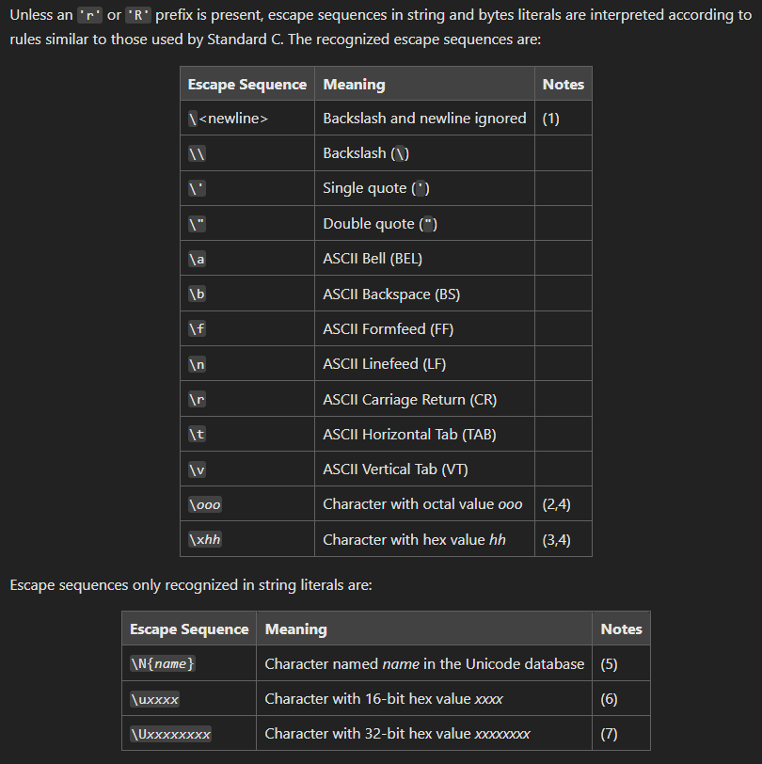
Data Types

Slide 12
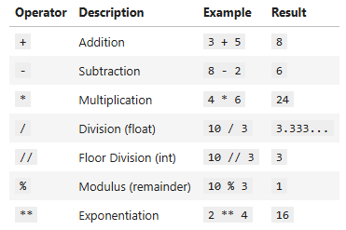
Operators
1. Arithmetic Operators
These operators perform mathematical calculations.

Slide 13
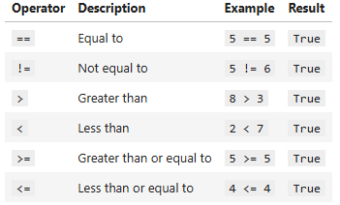
Operators
2. Comparison Operators
These operators compare values and return a boolean (True or False).

Slide 14
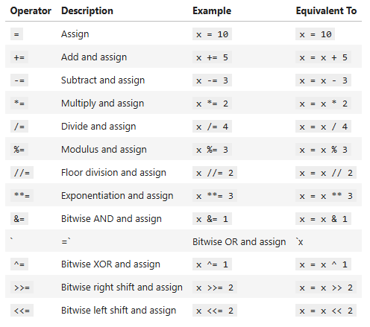
Operators
3. Assignment Operators
These operators assign values to variables.

Slide 15
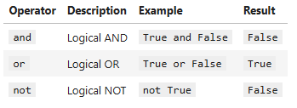
Operators
4. Logical Operators
These operators combine or modify boolean expressions.

Slide 16
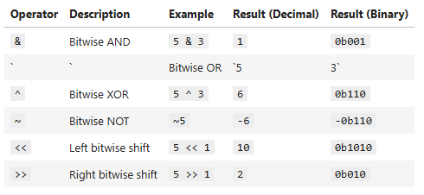
Operators
5. Bitwise Operators
These operators perform operations on individual bits of integers.

Slide 17

Operators
6. Membership Operators
These operators check if a value is present in a sequence.

Slide 18
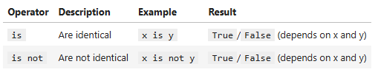
Operators
7. Identity Operators
These operators check if two variables refer to the same object in memory.

Slide 19
Operators
Operator Precedence
Python follows operator precedence rules. Parentheses have the highest precedence. Here's a simplified order:
() (Parentheses)
** (Exponentiation)
*, /, //, % (Multiplication, Division, Floor Division, Modulus)
+, - (Addition, Subtraction)
Comparison Operators
Assignment Operators
Logical Operators

Slide 20
Input Output
Input:
Console input can be used using input() method. input() displays the prompt given as an argument and waits for the user to type something and press Enter.
The entered text is always returned as a string. You must explicitly convert it to an integer (int()), float (float()), or other data type if needed.
It's good practice to provide clear prompts to the user so they know what kind of input is expected.
Output:
Console output can be provided using print() method. print() can take multiple arguments, separated by commas. It will automatically add spaces between them.
f-strings (formatted string literals) provide a concise way to embed variables directly within strings. They are very convenient and recommended for more complex output formatting.
str.format() is an older method that is still widely used and provides more fine-grained formatting control.
The end parameter of print() controls what character is printed at the end of the output. By default, it's a newline character (\n), which moves the cursor to the next line. Setting end="" prevents this.
Escape sequences like \n (newline), \t (tab), \" (double quote), and \\ (backslash) allow you to represent special characters within strings.

Slide 21
Flow Control
Sequential Execution (The Default):
By default, Python executes statements in the order they appear in the code, from top to bottom. This is sequential execution. While seemingly simple, it forms the foundation of all programs.
Conditional Statements:
if statement: Executes a block of code if a condition is true.
elif statement (else if): Checks another condition if the previous if condition is false. You can have multiple elif blocks.
else statement: Executes a block of code if none of the preceding if or elif conditions are true.
Nested if statements: You can nest if statements within other if, elif, or else blocks for more complex logic.
Match-Case Statement: It is Python's version of a switch-case found in other languages. It allows us to match a variable's value against a set of patterns.
Looping Statements:
for loop: Iterates over a sequence (like a list, tuple, string, or range) or other iterable object.
while loop: Repeats a block of code as long as a condition is true.
Nested loops: One loop inside another loop.

Slide 22
String Operations
Basic String Operations:
Concatenation (+): Combines two or more strings.
Repetition (*): Repeats a string a specified number of times.
Indexing ([]): Accesses individual characters in a string. Strings are zero-indexed.
Slicing ([start:stop:step]): Extracts a substring from a string.
Length (len()): Returns the number of characters in a string.
Membership (in, not in): Checks if a substring is present in a string.
String Methods (Modifying and Formatting):
lower(): Converts a string to lowercase.
upper(): Converts a string to uppercase.
strip(): Removes leading and trailing whitespace.
lstrip(): Removes leading whitespace.
rstrip(): Removes trailing whitespace.
replace(old, new): Replaces occurrences of a substring with another.
split(separator): Splits a string into a list of substrings based on a separator. Defaults to whitespace.
join(iterable): Joins elements of an iterable (e.g., list) into a string using a specified separator.
capitalize(): Capitalizes the first character of a string.
title(): Capitalizes the first character of each word in a string.
center(width, fillchar): Centers a string within a specified width, padding with a fill character (defaults to space).
ljust(width, fillchar): Left-justifies a string within a specified width.

Slide 23
String Operations
2. String Methods (Modifying and Formatting) [Contd.]:
m. rjust(width, fillchar): Right-justifies a string within a specified width.
n. zfill(width): Pads a numeric string with leading zeros.
3. String Methods (Searching and Checking):
a. find(substring): Returns the index of the first occurrence of a substring, or -1 if not found.
b. rfind(substring): Returns the highest index of a substring.
c. index(substring): Similar to find(), but raises a ValueError if the substring is not found.
d. rindex(substring): Similar to rfind, but raises ValueError.
e. count(substring): Returns the number of occurrences of a substring.
f. startswith(substring): Checks if a string starts with a specified substring.
g. endswith(substring): Checks if a string ends with a specified substring.
h. isalnum(): Checks if all characters are alphanumeric.
i. isalpha(): Checks if all characters are alphabetic.
j. isdigit(): Checks if all characters are digits.
k. islower(): Checks if all characters are lowercase.
l. isupper(): Checks if all characters are uppercase.
m. isspace(): Checks if all characters are whitespace.
n. istitle(): Checks if a string is titlecased.
4. f-strings (Formatted String Literals):
a. f-strings provide a concise and readable way to embed expressions within string literals.
b. f-strings can also use format specifiers.

Slide 24
Pythonic way of problem solving
1. Readability and Clarity:
Explicit is better than implicit: Write code that's easy to understand at a glance. Avoid overly clever or terse solutions.
Use descriptive variable names: Choose names that clearly indicate the purpose of variables.
Follow PEP 8 guidelines: Adhere to Python's style guide for consistent formatting, improving readability.
Use docstrings: Document your functions and modules to explain their purpose and usage.
Break down complex tasks into smaller, well-named functions: This makes code easier to understand and test.
2. Simplicity and Minimalism:
"There should be one-- and preferably only one --obvious way to do it.": Embrace Python's philosophy of simplicity.
Avoid unnecessary complexity: Don't overengineer solutions.
Leverage Python's built-in functions and libraries: Don't reinvent the wheel.
Use list comprehensions and generator expressions: These provide concise ways to create lists and iterators.
Use context managers (with statement): Simplify resource management (e.g., file handling).

Slide 25
Pythonic way of problem solving
3. Efficiency and Performance:
Choose appropriate data structures: Use sets for membership testing, dictionaries for key-value lookups, and lists for ordered collections.
Use generators for large datasets: Generators produce values on demand, saving memory.
Profile your code: Identify bottlenecks and optimize performance-critical sections.
Use libraries like NumPy and Pandas for numerical and data analysis tasks: These libraries provide highly optimized functions.
Avoid unnecessary loops: Try to use vectorized operations when possible.
4. Idiomatic Python:
Use enumerate for iterating with indices
Use zip for iterating over multiple sequences
Use if item: for checking if a list or other iterable is not empty
Use in for membership testing
Use try-except for handling exceptions gracefully
Use with to handle resources
Use unpacking

Slide 26
Functions
What are Functions?
A function is a block of organized, reusable code that performs a specific task.
They help break down complex programs into smaller, more manageable parts.
Functions promote code reusability, reducing redundancy and improving maintainability.
Types of Functions:
Built-in Functions:
These are functions that are readily available in Python, such as print(), len(), max(), min(), etc.
User-Defined Functions:
These are functions that you create yourself to perform specific tasks.
Lambda Functions (Anonymous Functions):
These are small, single-expression functions that can be defined without a name.

Slide 27
Functions
Defining a Function:
Use the def keyword followed by the function name and parentheses ().
Parameters (inputs) can be placed within the parentheses.
The function body is indented below the def statement.
The return statement is used to return a value from the function.
Function Arguments:
Positional Arguments:
Arguments are passed in the order they are defined.
Keyword Arguments:
Arguments are passed with their parameter names, allowing for flexibility in order.
Default Arguments:
Parameters can have default values, which are used if no argument is provided.
Arbitrary Arguments (*args):
Used to pass a variable number of positional arguments.
Arbitrary Keyword Arguments (**kwargs):
Used to pass a variable number of keyword arguments.

Slide 28
Functions
Return Values:
Functions can return values using the return statement.
If no return statement is present, the function returns None.
Key Benefits of Using Functions:
Code Reusability: Avoid writing the same code multiple times.
Modularity: Break down complex programs into smaller, manageable parts.
Readability: Improve code clarity and organization.
Maintainability: Easier to modify and debug code.
Lambda Functions:
Lambda functions are small, anonymous functions defined using the lambda keyword.
They are often used for simple operations.

Slide 29
Modules and Packages
Modules
Definition:
A module is a single Python file (.py) that contains Python code, such as functions, classes, and variables.
It serves as a unit of code organization, allowing you to group related code together.
Purpose:
To organize code for better readability and reusability.
To prevent naming conflicts by creating separate namespaces.
Usage:
You can import modules into other Python files using the import statement.
Examples of built-in modules include math, random, and os.

Slide 30
Modules and Packages
Packages
Definition:
A package is a collection of modules organized into a directory hierarchy.
It provides a way to structure and organize modules into logical groups.
A package directory must contain an __init__.py file (which can be empty in modern python), to be recognized as a python package.
Purpose:
To organize related modules into a hierarchical structure.
To provide a clear and consistent way to distribute and reuse code.
To help with managing large code bases.
Usage:
You can import modules from packages using dot notation (e.g., import package.module).
Packages can contain subpackages, further organizing the code.
Examples of popular packages include NumPy, Pandas, and Matplotlib.

Slide 31
Modules and Packages
Key Differences
Scope:
A module is a single file.
A package is a directory containing multiple modules and potentially subpackages.
Organization:
Modules organize code within a single file.
Packages organize related modules into a directory structure.
In summary:
Modules are the basic building blocks of Python code organization.
Packages provide a higher level of organization, allowing you to group related modules into logical units.

Slide 32
Class and OOPs
1. Classes and Objects:
Class:
A blueprint or template for creating objects.
It defines the attributes (data) and methods (functions) that objects of that class will have.
Object:
An instance of a class.
It has its own unique set of attributes and can use the methods defined in its class.
2. Encapsulation:
Bundling data (attributes) and methods (functions) that operate on that data within a single unit (class).
It helps protect data from unauthorized access and modification.
In Python, encapsulation is achieved through the use of access modifiers (though Python's implementation is less strict than in some other languages).
Python uses naming conventions, such as prefixing attributes with a single underscore (_) to indicate they are "protected" or a double underscore (__) to indicate they are "private" (with name mangling occurring).

Slide 33
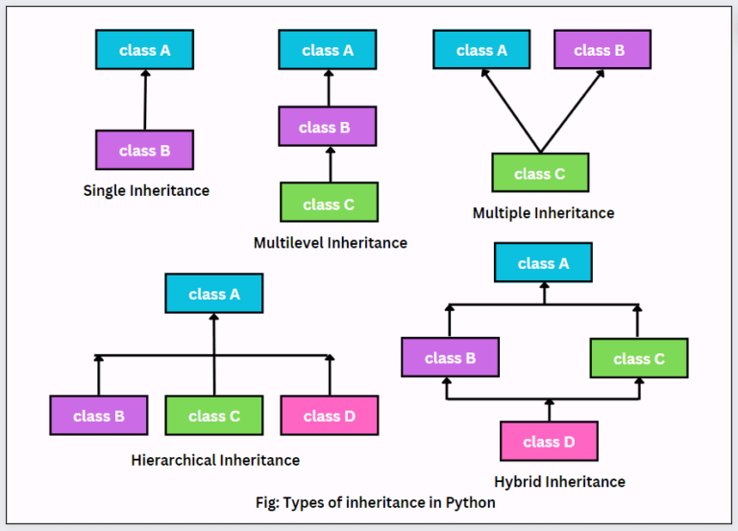
Class and OOPs
3. Inheritance:
A mechanism that allows a class (subclass or derived class) to inherit attributes and methods from another class (superclass or base class).
It promotes code reusability and creates a hierarchical relationship between classes.
The subclass can override or extend the functionality of the superclass.

Slide 34
Class and OOPs
4. Polymorphism:
The ability of objects of different classes to respond to the same method call in different ways.
It allows for flexibility and adaptability in code.
Python supports polymorphism through method overriding and duck typing (if it walks like a duck, and it quacks like a duck, then it must be a duck).
5. Abstraction:
Hiding complex implementation details and showing only the essential features of an object.
It simplifies the interface and reduces complexity.
Python achieves abstraction through abstract base classes (ABCs) and interfaces (though Python does not have explicit interfaces like some other languages).

